Slide 1

RU Hacks 2019
Freshest Hack Challenge

Slide 2

What is iTradeNetwork?
Copyright © iTradeNetwork 2019

Slide 3

HQ: San Francisco Bay Area (California)
5,000+ Customers (brands you’d easily recognize)
Deployed Globally
145 Employees
Founded in 1999
Copyright © iTradeNetwork 2019

Slide 4
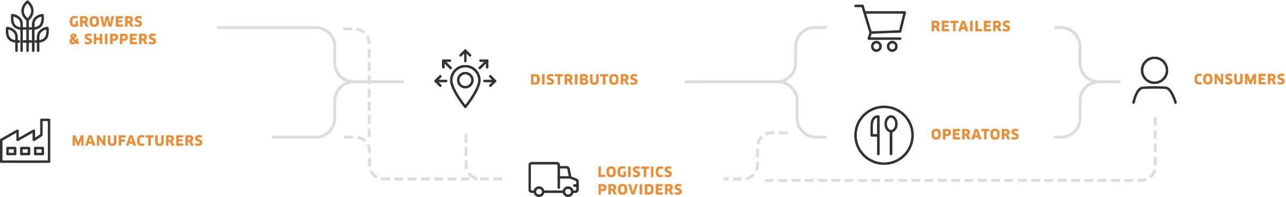
We partner with our 5,000+ client network to move food and beverages from their point-of-origin to their point-of-consumption, optimizing their supply chains along the way.
Order Management
Traceability
Quality Control
Rebate Management
Farm-to-Fork Analytics
A SaaS Platform for:

Slide 5
Some of what we do…
Copyright © iTradeNetwork 2019

Slide 6
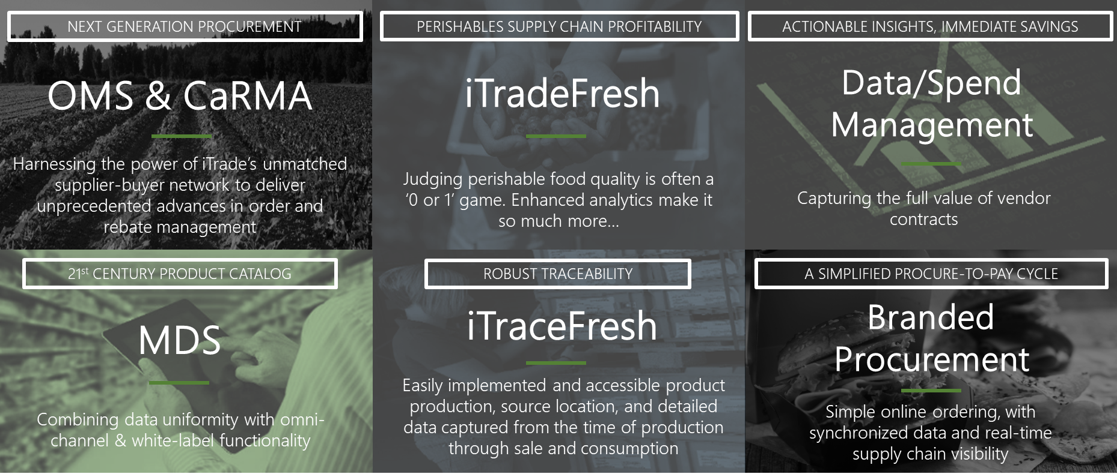
About iTradeNetwork: Product Portfolio

Slide 7

iTradeNetwork’s OMS (Order Management System) is the industry standard for fully integrated, end-to-end perishables order management.
Meet
OMS
(Order Management System)
7

Slide 8



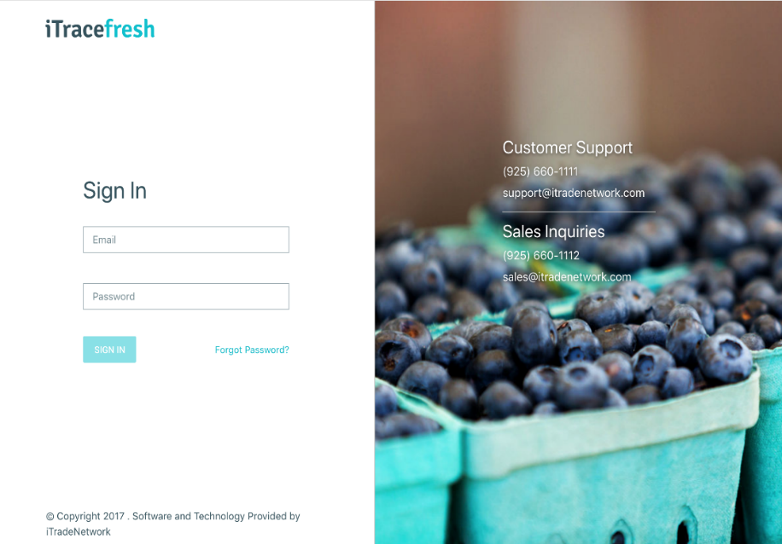
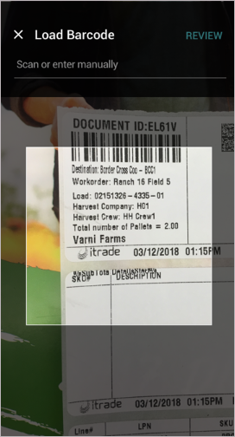
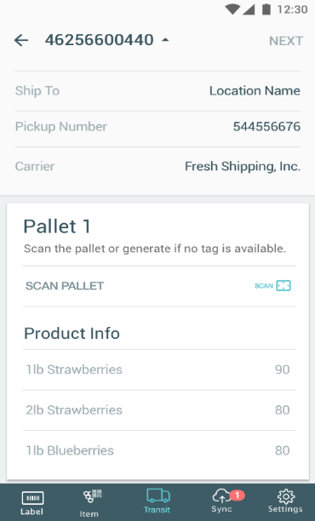
Ensure food safety and compliance on the industry’s leading food traceability software.
Meet
iTracefresh
8
Copyright © iTradeNetwork 2019

Slide 9

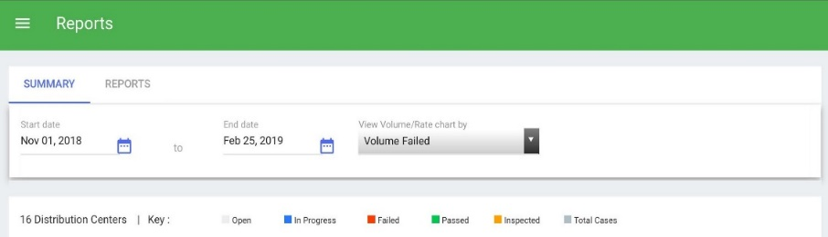

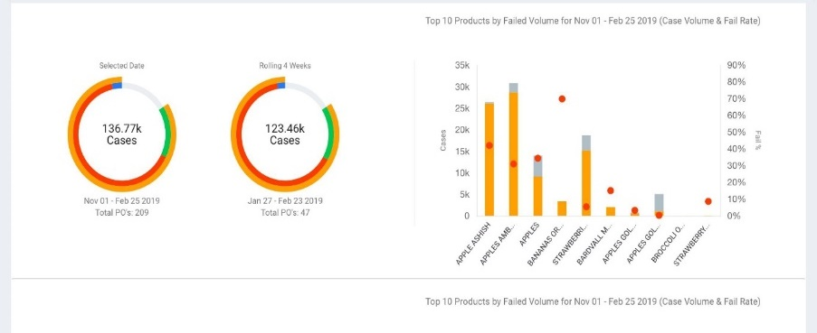
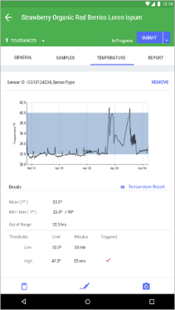
Meet
Ensures consistent produce quality by standardizing and guiding inspection processes, automating notifications, providing clear issue and vendor insights, and helping buyers source and procure the best product available on the market.
iTradeFresh
Inspect  Score  Analyze  Guarantee Quality
9

Slide 10
iTrade’s Data/Spend Management automates the collection and standardization of unit-level invoice data, allowing you to manage by exception and uncover opportunities for cost savings.
Meet
Spend/Data Management
10

Slide 11








iTrade Blockchain: The Industry’s First Homegrown Blockchain
GROWERS
& SHIPPERS
RETAILERS
DISTRIBUTORS
CONSUMERS
MANUFACTURERS
OPERATORS
LOGISTICS PROVIDERS
Example Capabilities
GS1 Data Pool | Rebate Management | Consumer Feedback | Mobile Delivery | ‘Fresh to Go’ | Load Tracking | Load Scheduling
GPS & Temp Tracking | Palletized ASN | Item Labeling | Case Labeling | Field Load Operations | Quality Inspection Analytics | Pricing Analysis
Demand Planning | Forecasting | Vendor Discovery | PO Management | PO Accounting | Substitutions | RFQ
A foundation of rich master data, product catalogs, and capabilities built for the perishables supply chain
Copyright © iTradeNetwork 2019
11

Slide 12
The Freshest Hack
Challenge…
Copyright © iTradeNetwork 2019

Slide 13
The Freshest Hack
The team that demonstrates and executes the most innovative feature, concept or module that could be applied to our Fresh and Trace products will win a prize! The feature, concept or module does not need to represent the entirety of your hackathon project, but it should be inspired by, or a functional piece of, your larger hackathon project.

Slide 14

Judging Criteria
Innovation
How unique is your idea?
Return on Investment
Can your idea make money and make the world a better place?
Quality and Polish
Is your idea cool and does it work?
Copyright © iTradeNetwork 2019

Slide 15
The iTrade
Challenge Prizes…
Copyright © iTradeNetwork 2019

Slide 16

Winning Team
$250 Visa gift card (per team member)

Slide 17

Sandbox
Cold Fusion Experience
Customer Support Software Developer
Quality You Can Guarantee
Internship and Job Opportunities
Copyright © iTradeNetwork 2019

